Slide 1
HISD JROTC CADET WORKSHOP
bbriggs@houstonisd.org
S3 TRAINING AND OPERATIONS OFFICER
27-29 July 2021

Slide 2
Admin
Be and active participant
Pay attention
Take notes
Stay on task
Be on time
Meals are mandatory
Restroom breaks when needed

Slide 3
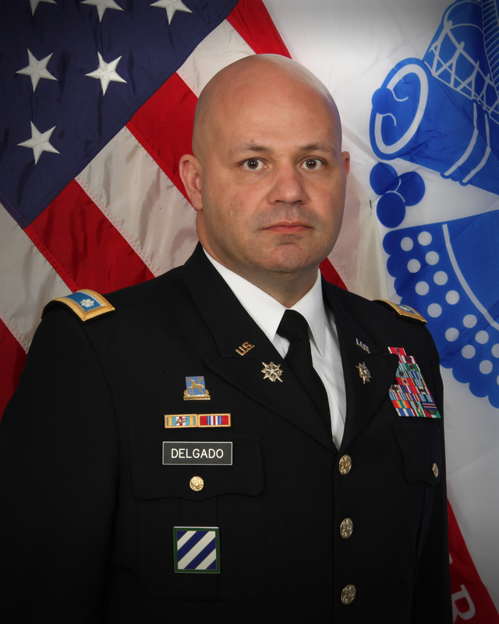
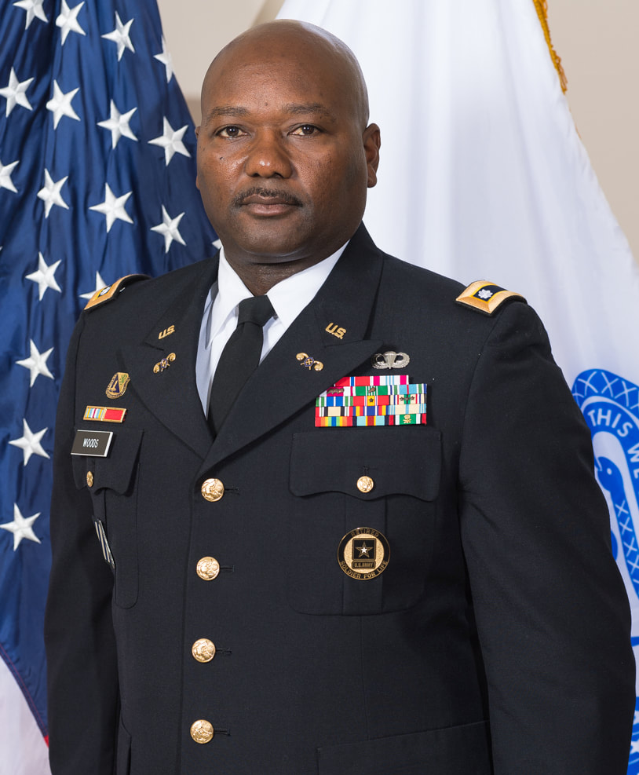
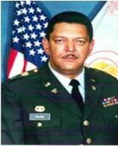
S3 WORKSHOP INSTRUCTORS & S3 CONNECTION
LTC JOSE DELGADO
Sharpstown HS
(713) 773-6137
jdelgad3@houstonisd.org
MAJ SHAWN MORTON
Waltrip HS
713-688-1361
Shawn.Morton@houstonisd.org
CPT KERWIN TREGE
Hightower HS
281-327-2210
Kerwin.tregre@fortbendisd.com
CADET BATTALION S3
ROSTER – PRINT NEATLY

Slide 4
Agenda
Tuesday 27 July 2021
Time | Subject | Location | Instructor
0940-1030 | Introduction to S3 Duties and responsibilities; Inspection preparation; JROTC S3 Training files | Rm D-102 | LTC Delgado /Committee
1030-1040 | Break | Break Area | Cadre
1040-1130 | DJROTC schedule of Events (SOE); School Calendar; Suspense Calendar/MTS/POI | Rm D-102 | S3 Training /Committee
1130-1210 | Lunch | Break Area | Cadre
1210-1400 | Recap & Computer set up | Rm D-102 | S3 Training /Committee
1400-UTC | Cadets assemble & return to respective schools | TBD | Cadre

Slide 5
Agenda
Wednesday 28 August 2021
Time | Subject | Location | Instructor
0900-0930 | S3 Prepare the First Six Weeks of Training Schedule | Rm D-102 | S3 Training /Committee
0930-0940 | Break | Break Area | Cadre
0940-1030 | S3 Prepare the First Six Weeks of Training Schedule - Continued | Rm D-102 | S3 Training /Committee
1030-1040 | Break | Break Area | Cadre
1040-1130 | S3 Prepare the First Six Weeks of Training Schedule - Continued | Rm D-102 | S3 Training /Committee
1130-1210 | Lunch | Break Area | Cadre
1210-1400 | S3 Prepare the First Six Weeks of Training Schedule - Continued | Rm D-102 | S3 Training /Committee
1400-UTC | Cadets assemble & return to respective schools | TBD | Cadre

Slide 6
Agenda
Thursday 29 August 2021
Time | Subject | Location | Instructor
0900-0940 | Risk Management | Rm D-102 | S3 Training /Committee
0940-1040 | Inspection Preparation OPORD/OPLAN/FRAGO | Rm D-103 | S3 Training /Committee
1030-1040 | Break | Break Area | Cadre
1040-1130 | Tng Schedules (Recap) | Rm D-102 | S3 Training /Committee
1130-1210 | Lunch | Break Area | Cadre
1210-1400 | Cadet Training summary/review | Rm D-102 | S3 Training /Committee
1400-UTC | Cadets assemble & return to respective schools | TBD | Cadre

Slide 7
Now your turn
About yourself:
Name, cadet rank, school
What job did you held last year?
Any experience in S3? Other staff experience?
What is your MS Office Proficiency level?
What are your challenges (you and your unit)?

Slide 8
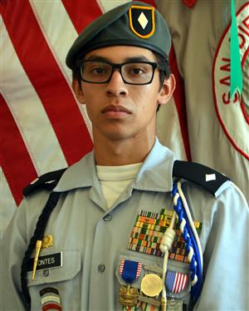
Who is the S3
And more important…..what they do?

Slide 9
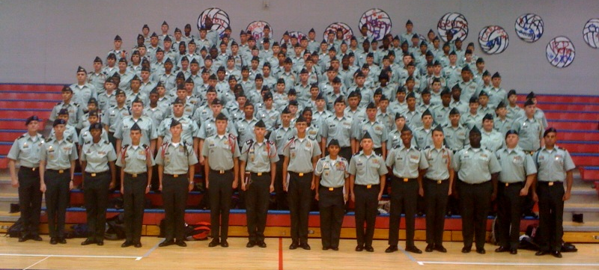
BATTALION S3
MOTTO:
“I AM MY UNIT’S S3, MY UNIT’S TRAINING & Operations DEPEND ON ME.”

Slide 10
What is the S3
Cadet Battalion Training Officer (S-3 — c/MAJ)
– Principal staff officer responsible for all matters concerning training, operations and plans
– Plans, Organizes and supervises the conduct of all Cadet training
– Prepares Orders (OPORDs & FRAGOs), training schedules & memoranda to facilitate battalion training and operations
– Serves on event staff for planning and conducting battalion training events

Slide 11
CADET S3 DUTIES AND RESPONSIBILITIES
TRAINING SCHEDULES
Prepares and publishes all training schedules (6 weeks in advance IAW DJROTC Tracker)
Prepares all training reports
Monitors all training and operations to ensure training objectives are met
PLANS AND OPERATIONS
Organizes and supervises all planning efforts – prepares documents supporting all unit’s activities (WARNORD, OPORD, FRAGO, tasking letters, MOI or LOI, unit report, permissions slips, etc.)
Completes risk management assessment and worksheet for ALL training
COORDINATION
Coordinates with school administration, community, agencies for logistical support, event enablers (guest speakers, etc.)
CADET CHALLENGE
Update JUMS – Training and Cadet Challenge

Slide 12
CADET S3 INSPECTION PREPARATION
DISTRICT TRAINING MANAGEMENT CHECKLIST
CADET COMMAND TRAINING MANAGEMENT (S3)AND SECURITY (S2) CHECKLIST
STAFF BRIEFING (S3)

Slide 13
JROTC TRAINING FILES (S3) 3-1 to 3-11
3-1 Training Memorandum and POI
3-2 Weekly Training Schedules
3-5 Memorandum of Instruction (MOI)
3-8 Houston ISD DJROTC Formal Inspection
3-9 Formal Inspection / JPA
3-10 JROTC Cadet Leadership Challenge
3-11 Cadet Challenge

Slide 14
3-1 Training Memorandum and POI
TRADOC Program Of Instruction
Training Memorandum Published by DJROTC
DJROTC & School Master Training Schedules
Yearly Schedule of Events
* DESTROY UPON RECEIPT OF NEW PUBLICATIONS *

Slide 15
3-2 Weekly Training Schedules
HISD JROTC Form 3-3
Maintain original on hand
Prepare copies for S3 records, bulleting boards, and classrooms
E-mail training schedules to DJROTC at least two weeks prior to the week of instruction
Constantly check the Training schedule turn in worksheet sent by DJROTC office
* DESTROY AFTER TWO YEARS*
Notes:
The Program of Instruction, POI, provides the minimum program requirements and identifies mandatory lessons for each LET level. The POI is based upon a systematic progression of learning. It builds upon previous capabilities but also allows instructors great deal of flexibility to meet school requirements.

Slide 16
3-5 MOI
MEMORANDUMS OF INSTRUCTION THAT PERTAIN TO ALL PLANNING, CONDUCTING AND SUPERVISING FIELD EVENTS.
* DESTROY WHEN NO LONGER NEEDED*

Slide 17
3-8 HISD DJROTC Formal Inspection
Letter of Instruction DJROTC Formal Inspection
Memorandum of Inspection Results DJROTC
Records of Corrective Actions Taken Since Last Inspection
Place in inactive file at the end of the school year
* DESTROY AFTER THREE YEARS *

Slide 18
3-9 Formal Inspection JROTC Program of Accreditation
Inspection every three years*****
Place in inactive file at the end of the school year
* DESTROY AFTER THREE YEARS *

Slide 19
3-10 JROTC Cadet Leadership Challenge
MOI
JCLC Fee Roster
JCLC Equipment Pick-up and Return Memorandum
JCLC Camp SOP
* DESTROY AFTER ONE YEAR *

Slide 20
3-11 Cadet Challenge
MOI for Cadet Challenge
Record of cadet scores and participation results
Place in inactive file at the end of the school year
* DESTROY WHEN NO LONGER NEEDED OR AFTER THREE YEARS *

Slide 21
Resources
Service’s JROTC
http://www.usarmyjrotc.com/
http://www.njrotc.navy.mil/
http://www.au.af.mil/au/holmcenter/AFJROTC/index.asp
HISD DJROTC
http://www.hisdjrotcoperations.com/
Sharpstown HS JROTC
http://www.houstonisd.org/site/default.aspx?PageID=109675

Slide 22
Questions? Comments Break before the next event

Slide 23
HISD JROTC Summer Workshop S3 Connection
 | Last name | First name | School | E-mail | Telephone #
1 | Perez | Danna | Hightower HS | Danna.Pl@strudent.fortbendisd.com
2 | Chavez | Dakota | Sam Houston HS | S1602673@houstonisd.org
3 | Hamilton | Ah’Taigea | Northside HS | S184459@houstonisd.org | 713-5515-7216
4 | Banuelos | Juvenal | Austin HS | S1629821@houstonisd.org
5 | Lopez | Jamilette | Milby HS | S1628339@houstonisd.org
6 | Sanchez | Esther | Wheatley HS | S1593495@houstonisd.org | 832-899-0345
7 | Guetierrez | Krystal | Scarborough HS | S1639747@houstonisd.org | 346-754-4453
8 | Hargett | Hayden | Klein Cain HS | hhar9920@students.kleinisd.net | 346-305-1255
9 | Cedillo | Ximena | BT Washinton HS | S1593718@online.houstonisd.org | 281-919-6804
10 | Urias | Karma | Waltrip HS | S1639929@online.houstonisd.org
11 | Castillo | Jaizel | McArthur HS | JC871176@aldine-isd.org
12 | Jackson | Robert | HL/JS | S1790301@online.houstonisd.org
13 | Garcia | Amaury | Westfield HS | GA33011929@gmail.com
14 | Escobar | Sophea | Bellaire HS | Sophea.orrellana@gmail.com | 832-379-2070
15 | Lopez | Dwayne | Lamar HS | lodwaynme500@gmail.com | 832-897-0316
16 | Aguilar | Virginia | Wisdom HS | elizaaguilar@gmail.com | 832-710-7067

Slide 24
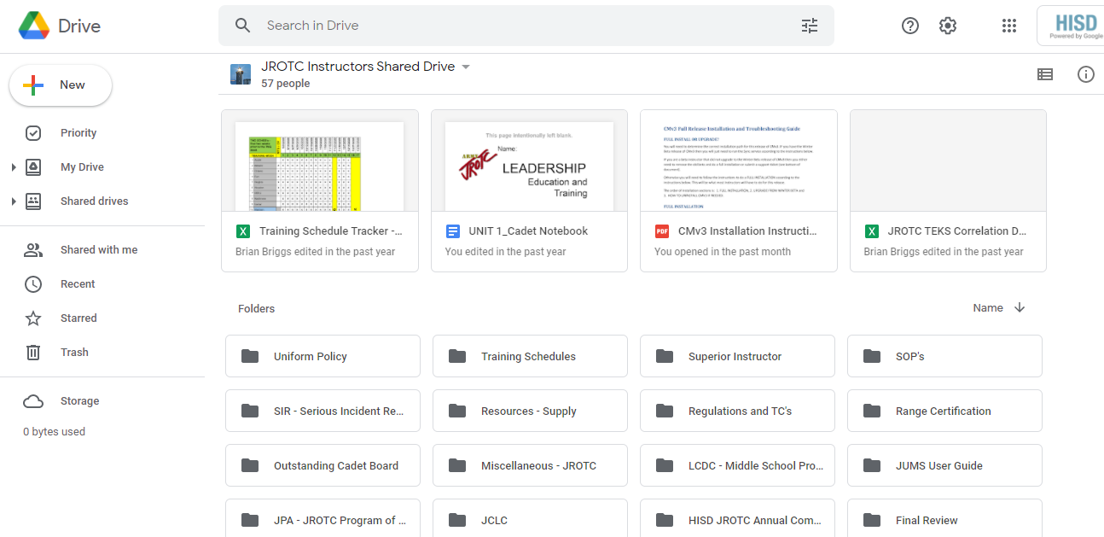
Our source

Slide 25
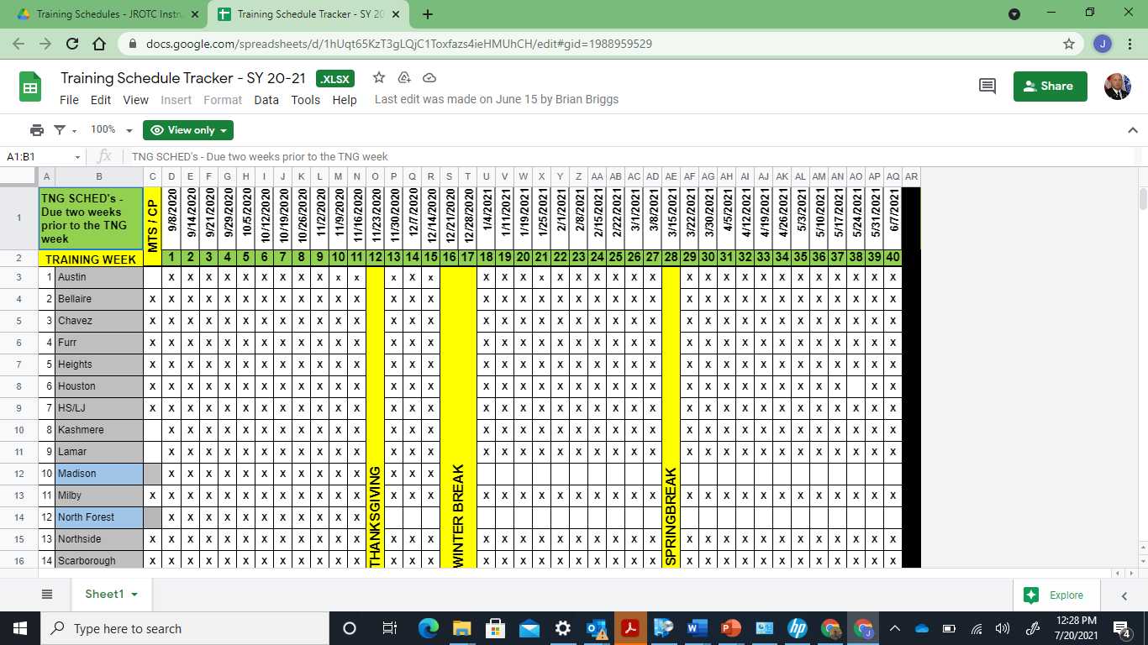
Training Schedule Tracker (HISD)

Slide 26
Training Schedule Tracker (HISD)

Slide 27
Training Schedule Tracker (HISD)

Slide 28
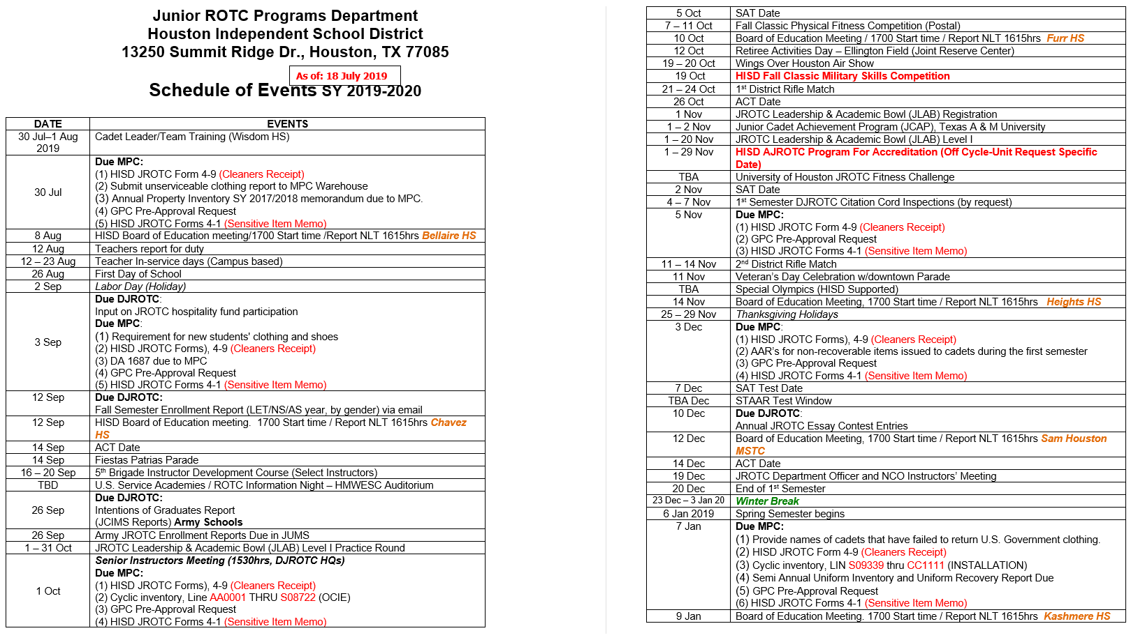
Schedule of Events

Slide 29
Key Events

Slide 30
Your ISD Academic Calendar

Slide 31
Questions

Slide 32
Admin - Laptops
login with the username and password that they used during the school year. If there is an issued logging in, have them use the following generic login:
Username: TBD
Password: TBD
At the end of the day or when the students are done using the laptops, have them place the laptop back in the cart and plug in the charger so that there is a full charge for the next day.

Slide 33
Instructions for JROTC Cadets to Establish a MyGoArmy.com account
Go to https://my.goarmy.com/accounts/register/user_agreement.jsp
Step 2.
Read the End User Agreement.
Click the “Accept” radio button located at the bottom of the agreement.
Click “Continue
Step 3.
Type in your first name, last name, date of birth, and e-mail address in the boxes provided.
If you fail to provide an e-mail address, you cannot create and account and your Army JROTC Instructor will not be able to set-up a JUMS account for you.
Type in your zip code.
Based on your personal preference check or leave unchecked the box adjacent to the statement “Please send me information about future Army Opportunities.”
Type the text as it appears in the image on the screen in the box provided.
Click “Continue.”

Slide 34
Instructions for JROTC Cadets to Establish a MyGoArmy.com account
Step 4.
Receive Email Confirmation.
A message has been sent to the email address you provided. This message contains a link; clicking that link will take you to the next step in the registration process.
Please note that some email programs might identify the message as "Spam", "Bulk" or "Junk" mail. If you do not receive the registration email within five or ten minutes of clicking the "Continue" button on the previous screen, please check your email program's "Junk" or "Bulk" mail folder.
Step 5.
Click the link provided in the email or enter the ENTIRE URL into your web browser (try to copy & paste).
** Upon verifying your email address, you will be redirected to the “Create an Account” page.

Slide 35
Instructions for JROTC Cadets to Establish a MyGoArmy.com account
Step 6.
Enter your month, day and year of birth from the drop down menus.
Type in a screen name.
Type in a password. Passwords must be between 8 and 15 characters and must contain at least on lowercase letter, one uppercase letter, and one non-alpha character.
Retype your password.
Click Finish.
Step 7.
You will be redirected to the Log in Screen.
Enter the e-mail address you provided in step 3 in the box provided.
Enter your password in the box provided.
Click “Log In.”
Step 8.
Provide your JROTC Instructor with the e-mail address used in step 7. This is the login ID your JROTC Instructor will set-up in JUMS.

Slide 36
Instructions for JROTC Cadets to Establish a MyGoArmy.com account
Step 9.
Once your JROTC instructor has set-up and entered your account email address information into JUMS, you will be able to login into JUMS using the e-mail address login and password you created in step 7.

Slide 37
Instructions to Establish account
Tips for getting your password, user name, 15 minute locked out message, and resolving error message
Forgot your user name or password?
Select the “Retrieve Lost User Name/Password” link under the “Registered Users Sign In” section of the GoArmyEd public page
Account Locked Out – You must wait 15 minutes
After 15 minutes, clear your browser’s cookies/browsing history and open a new window to enter your user name or password. Need help clearing cookies?
Scroll down to the footer section and select the “Technology Support” link
Next, select the Browser Settings link
Depending on the browser you are using, make sure to follow the steps in Delete Cookies section
If your user name or password is pre-populated, clear those fields and manually enter your username and password

Slide 38
Instructions to Establish account
Password Guidelines
Your password will need to be a minimum of 15 characters and maximum of 25 characters
Contain 2 upper and 2 lower case characters, 2 numbers, and 2 special characters ( ! @ # $ ^ _ - = , . ? )
Do not use the (+) symbol or space key in your password
You cannot reuse the 10 previous passwords
Your password must be at least 4 characters different than your previous password

